Slide 1
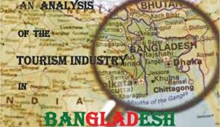
Tourism Industry In Bangladesh

Slide 2
WHAT IS TOURISM INDUSTRY
Tourism industry also known as travel industry. It is the idea of people travelling to other locations, either domestically or internationally, for leisure, social or business purposes.…

Slide 3
Tourist Spots in Bangladesh
Jaflong, Ratargul,Srimongal, Cox’s Bazar, Lalmai,Moinamoti and shalbon Bihar, Rangamati,Ahsan Manjil, Sundarban,Kuakata.

Slide 4
Importance of tourism
Tourism is an important driver of economic growth. Besides this , people have an opportunity to exchange culture. Tourism can earn huge amount of foreign currency. Tourism can support the Balance of payment (BOP) of a country. Tourism can create employment.

Slide 5
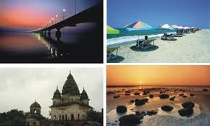
Impact of tourism
There are economic ,social-cultural and environmental key benefits of tourism.
1/Economic Benefits
2/Social Benefits
3/Environmental Benefits

Slide 6
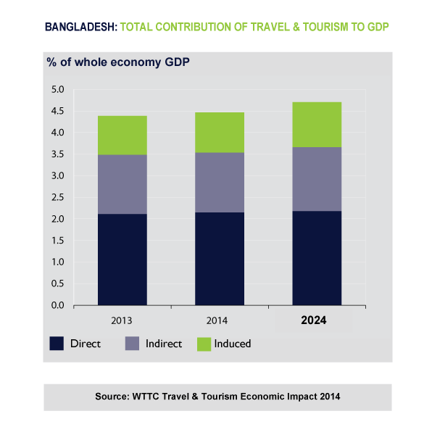
According to (WTTC) report (2014), the total contribution of travel and tourism was 4.4% of GDP in 2013 and is expected to grow 7.9%to 4.5% of GDP IN 2014.It is forecasted to rise by 6.5% per annum to 4.7% of GDP by 2024 .Notable that total contribution consists of direct, indirect and induced contribution

Slide 7
Negative effects of tourism are also not ignorable.
These are
1.Nagative economic effect
2.Negative social effects
3.Negative environmental effects

Slide 8
Objectives of tourism policy
To contrast various rules under the law where the main objectives is to fill in the gap of existing tourism rules .
To develop tourism industries through various planning related activates.
To create general awareness regarding tourism protection, development and exploration
To execute responsible tourism through creation of some helping hand on behalf of government like as personal sector, local sector, local administration, NGO, women federation, media.
To create a strong and safe foothold for the Bangladeshi tourist
To create tourism friendly environment in Bangladesh.
To develop human resource for tourism sector .

